Slide 1
Intro to Cloud Computing CS4037 (BCS-6A) Lecture 08
Danyal Farhat
FAST School of Computing
NUCES Lahore

Slide 2
Module 5: Networking and Content Delivery
AWS Academy Cloud Foundations

Slide 3
Module overview
Topics
Networking basics
Amazon VPC
VPC networking
VPC security
Amazon Route 53
Amazon CloudFront
Activities
Label a network diagram
Design a basic VPC architecture
Lab
Build your VPC and launch a web server

Slide 4
Module objectives
After completing this module, you should be able to:
Recognize the basics of networking
Describe virtual networking in the cloud with Amazon VPC
Label a network diagram
Design a basic VPC architecture
Indicate the steps to build a VPC
Identify security groups
Create your own VPC and add additional components to it to produce a customized network
Identify the fundamentals of Amazon Route 53
Recognize the benefits of Amazon CloudFront

Slide 5
Section 1: Networking basics
Module 5: Networking and Content Delivery

Slide 6
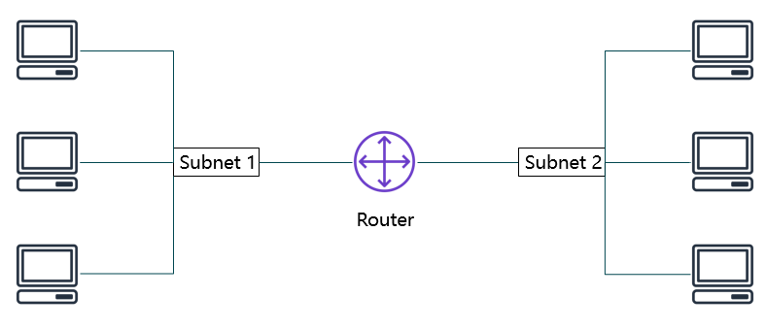
Networks
A computer network is two or more client machines that are connected together to share resources.
A network can be logically partitioned into subnets.
Networking requires a networking device (such as a router or switch) to connect all the clients together and enable communication between them.

Slide 7
IP addresses
Each client machine in a network has a unique Internet Protocol (IP) address that identifies it.
An IP address is a numerical label in decimal format.
Machines convert that decimal number to a binary format.

Slide 8
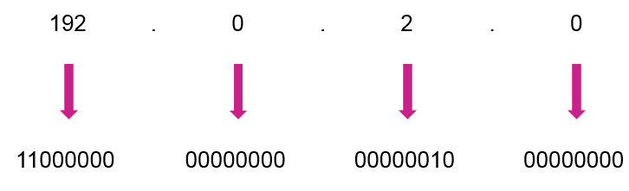
IP addresses
In this example, the IP address is 192.0.2.0.
Each of the four dot (.)-separated numbers of the IP address represents 8 bits in octal number format.
That means each of the four numbers can be anything from 0 to 255.
The combined total of the four numbers for an IP address is 32 bits in binary format.

Slide 9
IPv4 and IPv6 addresses
IPv4 (32-bit) address: 192.0.2.0
IPv6 (128-bit) address: 2600:1f18:22ba:8c00:ba86:a05e:a5ba:00FF

Slide 10
Classless Inter-Domain Routing (CIDR)
Network identifier (routing prefix)
Host identifier
192
.
0
.
2
.
0
/
24
Tells you how many bits are fixed
11000000
00000000
00000010
00000000 to 11111111
Fixed
Fixed
Fixed
Flexible

Slide 11
Open Systems Interconnection (OSI) model
Layer | Number | Function | Protocol/Address
Application | 7 | Means for an application to access a computer network | HTTP(S), FTP, DHCP, LDAP
Presentation | 6 | Ensures that the application layer can read the data Encryption | ASCI, ICA
Session | 5 | Enables orderly exchange of data | NetBIOS, RPC
Transport | 4 | Provides protocols to support host-to-host communication | TCP, UDP
Network | 3 | Routing and packet forwarding (routers) | IP
Data link | 2 | Transfer data in the same LAN network (hubs and switches) | MAC
Physical | 1 | Transmission and reception of raw bitstreams over a physical medium | Signals (1s and 0s)

Slide 12
Section 2: Amazon VPC
Module 5: Networking and Content Delivery

Slide 13
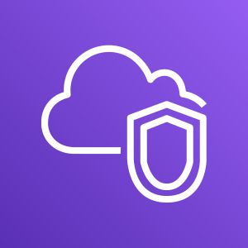
Amazon VPC
Enables you to provision a logically isolated section of the AWS Cloud where you can launch AWS resources in a virtual network that you define
Gives you control over your virtual networking resources, including:
Selection of IP address range
Creation of subnets
Configuration of route tables and network gateways
Enables you to customize the network configuration for your VPC
Enables you to use multiple layers of security
Amazon VPC

Slide 14
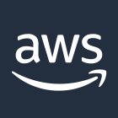

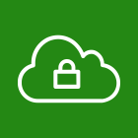
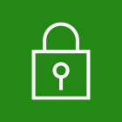
VPCs and subnets
VPCs:
Logically isolated from other VPCs
Dedicated to your AWS account
Belong to a single AWS Region and can span multiple Availability Zones
Subnets:
Range of IP addresses that divide a VPC
Belong to a single Availability Zone
Classified as public or private
Public subnets have direct access to the internet, but private subnets do not.
AWS Cloud
Region
Availability Zone 1
Availability Zone 2
VPC
Subnet
Subnet

Slide 15
IP addressing
When you create a VPC, you assign it to an IPv4 CIDR block (range of private IPv4 addresses).
You cannot change the address range after you create the VPC.
The largest IPv4 CIDR block size is /16.
The smallest IPv4 CIDR block size is /28.
IPv6 is also supported (with a different block size limit).
CIDR blocks of subnets cannot overlap.
You cannot have duplicate IP addresses in the same VPC.
VPC
x.x.x.x/16 or 65,536 addresses (max)
to x.x.x.x/28 or 16 addresses (min)

Slide 16
Reserved IP addresses
Example: A VPC with an IPv4 CIDR block of 10.0.0.0/16 has 65,536 total IP addresses. The VPC has four equal-sized subnets. Only 251 IP addresses are available for use by each subnet because five IPs are reserved.
IP Addresses for CIDR block 10.0.0.0/24 | Reserved for
10.0.0.0 | Network address
10.0.0.1 | Internal communication
10.0.0.2 | Domain Name System (DNS) resolution
10.0.0.3 | Future use
10.0.0.255 | Network broadcast address
VPC: 10.0.0.0/16
Subnet 1 (10.0.0.0/24)
Subnet 2 (10.0.2.0/24)
251 IP addresses
251 IP addresses
Subnet 4 (10.0.1.0/24)
Subnet 3 (10.0.3.0/24)
251 IP addresses
251 IP addresses

Slide 17
Public IP address types
Public IPv4 address
Manually assigned through an Elastic IP address
Automatically assigned through the auto-assign public IP address settings at the subnet level
When you create a VPC, every instance in that VPC gets a private IP address automatically.
Elastic IP address
Associated with an AWS account
Can be allocated and remapped anytime
Additional costs might apply

Slide 18
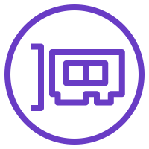
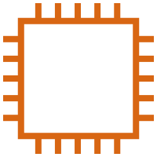
Elastic network interface
An elastic network interface is a virtual network interface that you can:
Attach to an instance.
Detach from the instance, and attach to another instance to redirect network traffic.
Its attributes follow when it is reattached to a new instance.
Each instance in your VPC has a default network interface that is assigned a private IPv4 address from the IPv4 address range of your VPC.
Subnet: 10.0.1.0/24
Elastic network interface

Slide 19
Route tables and routes
A route table contains a set of rules (called routes) that you can configure to direct network traffic from your subnet.
Each route specifies a destination and a target.
Destination is the destination CIDR block where you want traffic from your subnet to go.
The target is the target that the destination traffic is sent through.
By default, every route table contains a local route for communication within the VPC.
You can customize route tables by adding routes.
You cannot delete the local route entry that is used for internal communications.
DB and Web Server Example
Main (Default) Route Table
Destination | Target
10.0.0.0/16 | local
VPC CIDR block

Slide 20
Route tables and routes
Each subnet must be associated with a route table (at most one).
The main route table is the route table is automatically assigned to your VPC.
It controls the routing for all subnets that are not explicitly associated with any other route table.
A subnet can be associated with only one route table at a time, but you can associate multiple subnets with the same route table.
Main (Default) Route Table
Destination | Target
10.0.0.0/16 | local
VPC CIDR block

Slide 21

Section 2 key takeaways
A VPC is a logically isolated section of the AWS Cloud.
A VPC belongs to one Region and requires a CIDR block.
A VPC is subdivided into subnets.
A subnet belongs to one Availability Zone and requires a CIDR block.
Route tables control traffic for a subnet.
Route tables have a built-in local route.
You add additional routes to the table.
The local route cannot be deleted.

Slide 22
Section 3: VPC networking
Module 5: Networking and Content Delivery

Slide 23
Internet gateway
An internet gateway is a scalable, redundant, and highly available VPC component that allows communication between instances in your VPC and the internet.
An internet gateway serves two purposes:
To provide a target in your VPC route tables for internet-routable traffic
To perform network address translation for instances that were assigned public IPv4 addresses.
To make a subnet public:
You attach an internet gateway to your VPC
Add a route to the route table to send non-local traffic through the internet gateway to the internet (0.0.0.0/0).

Slide 24
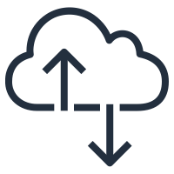
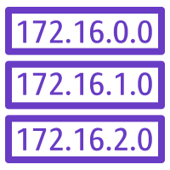
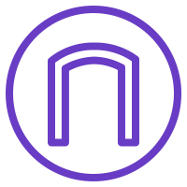

Internet gateway
AWS Cloud
Region
Availability Zone
VPC: 10.0.0.0/16
Public Subnet Route Table
Public subnet:10.0.1.0/24
Destination | Target
10.0.0.0/16 | local
0.0.0.0/0 | igw-id
Private subnet: 10.0.2.0/24
Route table
Internet gateway
(igw-id)
Internet

Slide 25
Network Address Translation (NAT) gateway
A network address translation (NAT) gateway enables instances in a private subnet to connect to the internet or other AWS services, but prevents the internet from initiating a connection with those instances.
To create a NAT gateway:
You must specify the public subnet in which the NAT gateway should reside
You must also specify an Elastic IP address to associate with the NAT gateway when you create it.
After you create a NAT gateway, you must update the route table that is associated with one or more of your private subnets to point internet-bound traffic to the NAT gateway. Thus, instances in your private subnets can communicate with the internet.

Slide 26
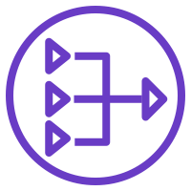
Network address translation (NAT) gateway
AWS Cloud
Region
Availability Zone
VPC: 10.0.0.0/16
Public subnet:10.0.1.0/24
Public Subnet Route Table
Public route table
Destination | Target
10.0.0.0/16 | local
0.0.0.0/0 | igw-id
NAT gateway (nat-gw-id)
Private subnet: 10.0.2.0/24
Internet gateway
(igw-id)
Private route table
Private Subnet Route Table
Internet
Destination | Target
10.0.0.0/16 | local
0.0.0.0/0 | nat-gw-id

Slide 27
VPC Sharing
VPC sharing enables customers to share subnets with other AWS accounts in the same organization.
In this model, the account that owns the VPC (owner) shares one or more subnets with other accounts (participants) that belong to the same organization.
After a subnet is shared
Participants can view, create, modify, and delete their application resources in the subnets that are shared with them.
Participants cannot view, modify, or delete resources that belong to other participants or the VPC owner.

Slide 28
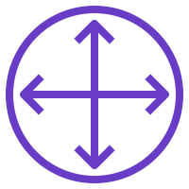
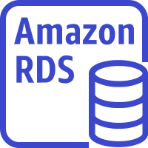
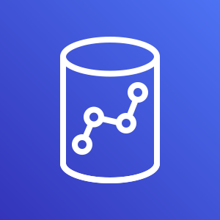
VPC Sharing
AWS Cloud
Region
VPC: Account A (owner)
Private subnet
Router
Public subnet
Account D (participant)
Account B (participant)
Account C (participant)
NAT gateway
Internet gateway
EC2 instance
EC2 instance
EC2 instance
RDS instance
Amazon Redshift
EC2 instance

Slide 29
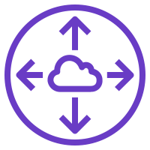
VPC Peering
AWS Cloud
A VPC peering connection is a networking connection between two VPCs that enables you to route traffic between them privately.
You can connect VPCs in your own AWS account, between AWS accounts, or between AWS Regions.
Restrictions:
IP spaces cannot overlap.
Transitive peering is not supported. A=>B=>C != A=>C
You can only have one peering resource between the same two VPCs.
VPC A: 10.0.0.0/16
VPC B: 10.3.0.0/16
Peering connection (pcx-id)
Route Table for VPC A
Route Table for VPC B
Destination | Target
10.0.0.0/16 | local
10.3.0.0/16 | pcx-id
Destination | Target
10.3.0.0/16 | local
10.0.0.0/16 | pcx-id

Slide 30
AWS Site-to-Site VPN
By default, instances that you launch into a VPC cannot communicate with a remote network.
To connect your VPC to your remote network, you:
Create a new Virtual Private Network (VPN) gateway and attach it to your VPC.
Define the configuration of the customer gateway and VPN gateway.
Create a custom route table to point corporate data center-bound traffic to the VPN gateway. You also must update security group rules.
Establish a Site-to-Site VPN connection to link the two systems together.
Configure routing to pass traffic through the connection.

Slide 31
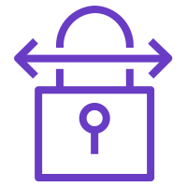
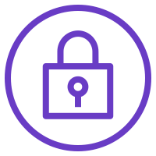
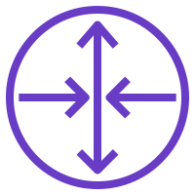
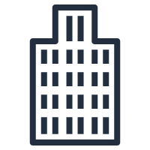
AWS Site-to-Site VPN
AWS Cloud
Public subnet route table
Region
Destination | Target
10.0.0.0/16 | local
0.0.0.0/0 | igw-id
Availability Zone
VPC: 10.0.0.0/16
Site-to-Site VPN connection
Public subnet:10.1.0.0/24
Private subnet route table
Internet
Destination | Target
10.0.0.0/16 | local
192.168.10.0/24 | vgw-id
Private subnet: 10.0.2.0/24
Route table
Virtual gateway (vgw-id)
Customer gateway
Corporate data center: 192.168.10.0/24

Slide 32
AWS Direct Connect
One of the challenges of network communication is network performance.
Performance can be negatively affected if your data center is located far away from your AWS Region.
For such situations, AWS offers AWS Direct Connect, or DX.
AWS Direct Connect enables you to establish a dedicated, private network connection between your network and one of the DX locations.
This private connection can reduce your network costs, increase bandwidth throughput, and provide a more consistent network experience than internet-based connections.
DX uses open standard 802.1q virtual local area networks (VLANs).

Slide 33
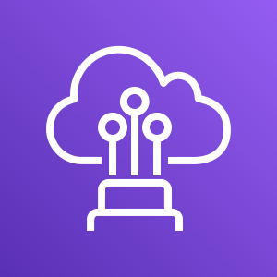
AWS Direct Connect
AWS Cloud
Region
Availability Zone
Internet
VPC: 10.0.0.0/16
Public subnet:10.1.0.0/24
802.1q VLAN
AWS Direct Connect
Private subnet: 10.0.2.0/24
Route table
Virtual gateway
Customer gateway
Corporate data center: 192.168.10.0/24

Slide 34
VPC Endpoints
A VPC endpoint is a virtual device that enables you to privately connect your VPC to supported AWS services and VPC endpoint services that are powered by AWS PrivateLink.
Connection to these services does not require an internet gateway, NAT device, VPN connection, or AWS Direct Connect connection.
Instances in your VPC do not require public IP addresses to communicate with resources in the service.
Traffic between your VPC and the other service does not leave the Amazon network.

Slide 35
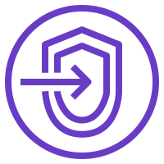
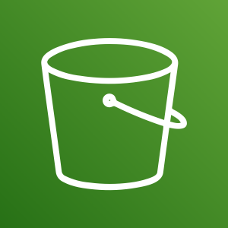
VPC Endpoints
AWS Cloud
Default DNS hostname or endpoint-specific DNS hostname
Public Subnet Route Table
Destination | Target
10.0.0.0/16 | local
Amazon S3 ID | vpcep-id
Region
Availability Zone
VPC: 10.0.0.0/16
Public subnet:10.0.1.0/24
Two types of endpoints:
Interface endpoints (powered by AWS PrivateLink)
Hourly usage rates and data processing rates apply.
Gateway endpoints (Amazon S3 and Amazon DynamoDB)
Incurs no additional charge.
VPC endpoint
(vpcep-id)
Amazon Simple Storage Service (Amazon S3)
Private subnet: 10.0.2.0/24
Elastic Network Interface

Slide 36
AWS Transit Gateway
It is not uncommon to find AWS customers with hundreds of VPCs distributed across AWS accounts and Regions to serve multiple lines of business, teams, projects, and so forth.
Things get more complex when customers start to set up connectivity between their VPCs (i.e. VPC Peering).
All the connectivity options are strictly point-to-point, so the number of VPC-to-VPC connections can grow quickly.
As you grow the number of workloads that run on AWS, you must be able to scale your networks across multiple accounts and VPCs to keep up with the growth.

Slide 37
AWS Transit Gateway
Though you can use VPC peering to connect pairs of VPCs, managing point-to-point connectivity across many VPCs without the ability to centrally manage the connectivity policies can be operationally costly and difficult.
For on-premises connectivity, you must attach your VPN to each individual VPC. This solution can be time-consuming to build and difficult to manage when the number of VPCs grows into the hundreds.
To solve this problem, you can use AWS Transit Gateway to simplify your networking model.
With AWS Transit Gateway, you only need to create and manage a single connection from the central gateway into each VPC, on-premises data center, or remote office across your network.

Slide 38
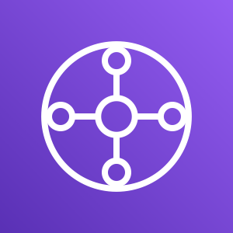
AWS Transit Gateway
From this…
To this…
AWS Direct Connect gateway
Customer gateway
VPN connection
Amazon VPC
VPC peering
Amazon VPC
Amazon VPC
Amazon VPC
VPN connection
VPC peering
VPC peering
VPC peering
AWS Direct Connect gateway
AWS Transit Gateway
VPN connection
Amazon VPC
Amazon VPC
Amazon VPC
VPC peering
Amazon VPC
VPN connection

Slide 39
Activity: Label this network diagram
AWS Cloud
?
?
?
Public subnet:10.0.1.0/24
?
?
Internet
?
_?_ IP address
Q6
?
Destination | Target
? | local
0.0.0.0/0 | ?
Private subnet: 10.0.2.0/24
?
?
?
_?_ IP address
10.0.0.0/16

Slide 40
Activity: Solution
AWS Cloud
Region
Availability Zone
VPC
Public subnet:10.0.1.0/24
Public subnet
Route table
Internet gateway
Internet
Private IP address
NAT gateway
Route
Destination | Target
10.0.0.0/16 | local
0.0.0.0/0 | igw-id
Private subnet
Private subnet: 10.0.2.0/24
Route table
Elastic network interface
Private IP address
10.0.0.0/16

Slide 41
Section 3 key takeaways
There are several VPC networking options, which include:
Internet gateway
NAT gateway
VPC endpoint
VPC peering
VPC sharing
AWS Site-to-Site VPN
AWS Direct Connect
AWS Transit Gateway
You can use the VPC Wizard to implement your design.

Slide 42
Thank you
All trademarks are the property of their owners.

